Slide 1
Masked Face Recognition
Group Members:
22101423-Mustakim Al Mahmud
24141100-Anwesha Roy
24141032-MD. Rezwanur Rahman
24141083-Ronodeep Bhowmik

Slide 2
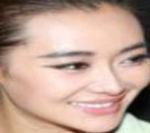
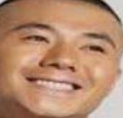
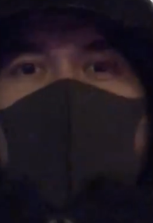
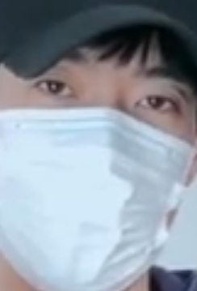
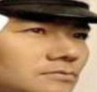
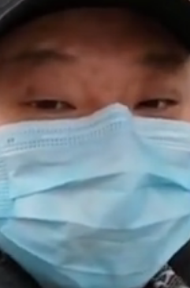
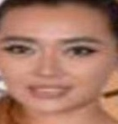
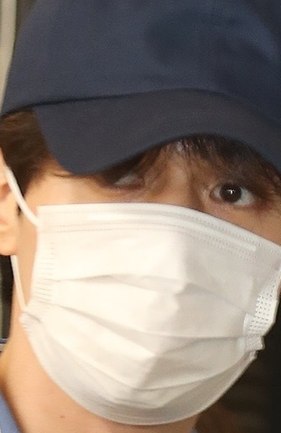
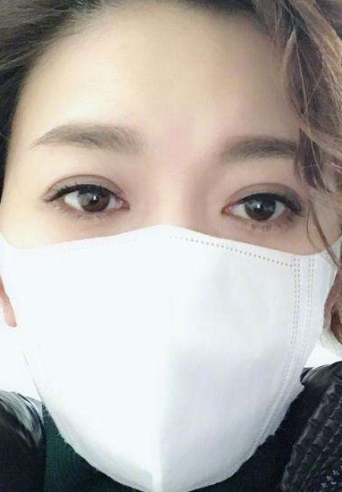
Face Mask Detection Using Deep Learning
THE DATA WE ARE USING IN THIS PROJECT
With Mask 1915
Without Mask 1918
Data Link - https://drive.google.com/drive/folders/1kHHmEIQYw-MkAsgpNz3OpJK49rTL_pwi?usp=sharing

Slide 3
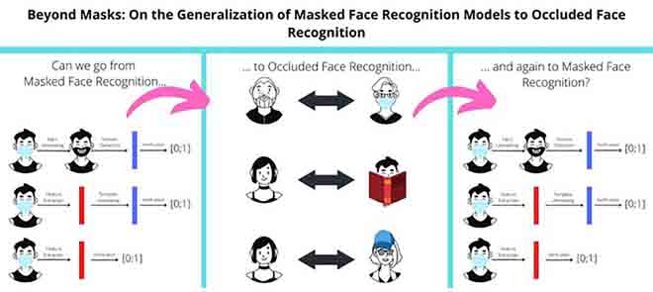
PAPER OVERVIEW
Paper links
http://surl.li/stjhn
http://surl.li/stjjo
“Mask The Face” and “Masked Face-Net”
Generative Adversarial Network (GAN)-faces mode collapse, is slow, and is challenging to operate online.
DSA-Face model(Download Scientific Diagram)
“AMaskNet”
End-to-End Training Technique.

Slide 4
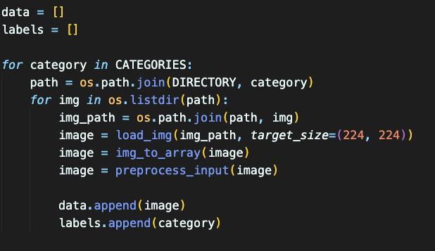
CODE OVERVIEW
Training Model: Image Recognition (Train_mask_detector.py)
Deploying Model: Real-time Detection ( Detect_mask_video.oy)
Loading and Preprocessing Images code:
Training The Model: Train-mask-detector.py
Dataset: “With Mask” & “Without Mask”
Transfer Learning with MobileNetV2

Slide 5
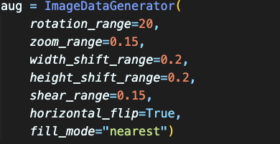
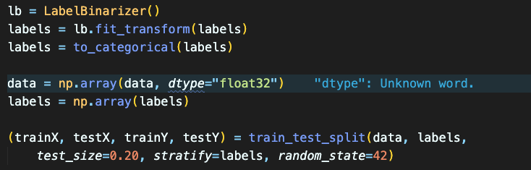
Real-Time Mask Detection: Detect-mask-video.py
Using OPENCV face detection
Applying Trained Model to Video Streams
Data Augmentation code:
Significance of the Project:
Intersection of Technology & Public Health
Addressing Pressing needs in Society
Label Encoding and Data Splitting code:

Slide 6
THANK YOU

